Slide 1
Timers

Slide 2
Timers
The Timers module provides a way scheduling functions to be called later at a given time.
Node.js Timer functions are global functions. You don't need to use require() function in order to use timer functions.

Slide 3
Timer functions
setImmediate(): It is a special timer that runs in a separate phase of the event loop.
It schedules callbacks to execute after the poll phase has completed.
setInterval(): It is used to define a time interval.
setTimeout(): It is used to execute a one-time callback after delay milliseconds.

Slide 4
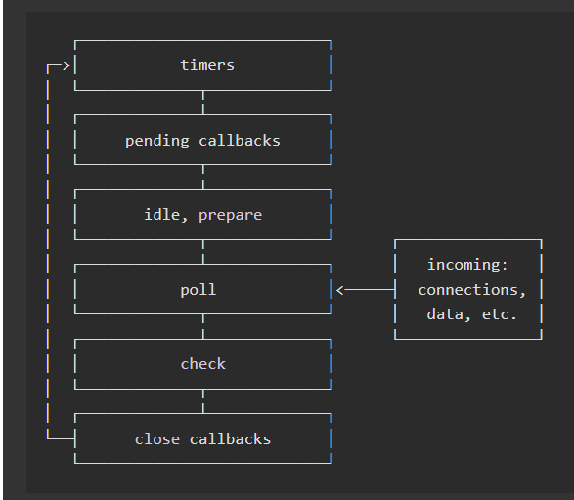
Overview of the event loop's order of operations.
https://nodejs.org/en/docs/guides/event-loop-timers-and-nexttick/

Slide 5
Timer functions
clearImmediate(immediateObject): It is used to stop an immediateObject, as created by setImmediate
clearInterval(intervalObject): It is used to stop an intervalObject, as created by setInterval
clearTimeout(timeoutObject): It prevents a timeoutObject, as created by setTimeout

Slide 6
Timer functions
setImmediate() : This method will execute the code after the end of current cycle of the event loop.

Slide 7
Timer functions
setInterval() : If there is a block of code that we want to run multiple times , we can use setInterval() to execute that code.
This method takes a function as its first argument which will run infinitely with a delay given in milliseconds as the second argument.

Slide 8
Timer functions
setTimeout() : This method can be used to execute a function after a designated amount of delay. This method accepts function as its first argument and the delay in milliseconds as second argument

